Slide 1
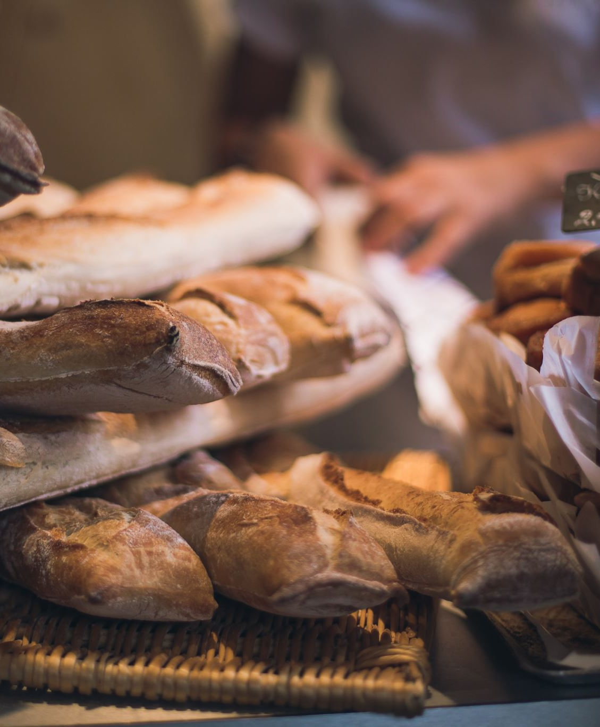
FOOD INSECURITY
GROUP 6
MICHAEL CICCHINO
VASILIY KONDRATYEV
BRENTON FENDER
EMERY SCOTT
WOYRAM ALMARANTE

Slide 2

TOPIC AND REASONING
Food Insecurity is defined as “a lack of consistent access to enough food for every person in a household to live an active, healthy life”. (USDA, 2023).
Based on the increasing rate of inflation following the recent global events, how secure are households in the USA?
What are the factors that impact food insecurity?
Is there enough data to reveal trends and predict how access to food sources impact food insecurity.

Slide 3
DESCRIPTION OF DATA : RESTAURANT DATA (X-FEATURE )
Fast-food restaurants/1,000 pop (% change), 2011-16
Full-service restaurants/1,000 pop (% change), 2011-16
Expenditures per capita, fast food, (% change) 2007-12
Expenditures per capita, restaurants, (% change) 2007-12

Slide 4
DESCRIPTION OF DATA: STORES DATA (X-FEATURE)
VARIABLES
Grocery stores/1,000 pop (% change), 2011-16
Supercenters & club stores/1,000 pop (% change), 2011-16
Convenience stores/1,000 pop (% change), 2011-16
Specialized food stores/1,000 pop (% change), 2011-16

Slide 5
DESCRIPTION OF DATA: INSECURITY DATA(Y)
Household food insecurity (%, three-year average), 2017-19*
Household food insecurity (change %),2014-16 to 2017-19*
BI_Model-Household food insecurity (change %),2014-16 to 2017-19*

Slide 6

RESEARCH QUESTION
Main Hypothesis:
How does physical access to food through restaurants and grocery stores impact food insecurity?
Sub Hypotheses:
How is fast-food expenditure related to food insecurity?
Does restaurant availability contribute to lowering food insecurity?
Which has a higher positive impact on food access: having more farmers markets or more general grocery stores?
How does agritourism influence food insecurity?
How do community supported farms verses regular farms have an impact on food insecurity?

Slide 7

DESCRIPTION OF DATA EXPLORATION PHASE
Data was reviewed from the USDA website regarding food insecurity and was transformed and cleaned to be analyzed by Team 6 members.
The team refined the feature variables to restaurants and stores. Using these feature variables, the team members intend to predict future food insecurity.
The feature variables refer to data covering the duration from 2007 to 2016.
The predictor variable is food insecurity from 2017 to 2019.

Slide 8
DESCRIPTION OF ANALYSIS PHASE
The team chose to predict a binary increase or decrease in food insecurity with time period spanning from 2017 to 2019.
Team 6 recognized a skewed /imbalanced nature of the y-variable.
The team utilized two methods to account for this imbalance being Balanced Random Forest Classifier and Easy Ensemble AdaBoost Classifier.

Slide 9

THE TECHNOLOGIES, LANGUAGES, TOOLS AND ALGORITHMS THAT THE TEAM USED THROUGHOUT THE PROJECT
Slack
Github
EXCEL
PYTHON-
Jupyter Notebook
Sklearn
Pandas Library
imblearn
ERD Generator- QuickDBD (quickdatabasediagrams.com)
PostgreSQL (pgAdmin)
Tableau
Zoom

Slide 10
REFERENCES
USDA, 2023
https://www.ers.usda.gov/webdocs/publications/45020/30967_err141.pdf
USDA ERS - Data Access and Documentation Downloads
https://www.ers.usda.gov/webdocs/publications/44906/6893_err125_2_.pdf?v=5244
2009-2011 food insecurity data
https://www.ers.usda.gov/webdocs/publications/45020/30967_err141.pdf
2011-2013 food insecurity data https://www.ers.usda.gov/webdocs/publications/45265/48787_err173.pdf
2014-2016 food insecurity data https://www.ers.usda.gov/webdocs/publications/84973/err-237.pdf?v=219.4

